Slide 1


Rock Paper scissor
Group - 5

Slide 2
Group Members
NAME | ID
PUSPITA SARKER | 200145
BISWAJIT DEB | 200146
NASIF SHAHRIER NAFI | 200147
ARIFUL ISLAM | 200149
MUNNI KHANOM | 200150
ABDULLAH ABU-SAEED | 200151
SAJID HASAN TAKBIR | 200152
ANAMIKA MARMA | 200153
OVESHEK KUNDU TOTON | 200154

Slide 3

INTRODUCTION
The game is called Rock, Paper and Scissor.
It is quite simple. It’s played between two players.
Rock can smash scissor, paper can grab rock and scissor can cut paper.
Whoever win gets a point.
We’ve two modes in this game. You can either play the game with computer or play it with your friend.
We’ve added scoreboard to keep track of the score.

Slide 4
Objectives
Healthy brain stimulation.
Stress relief.
Mental health benefits.
Improved mood.

Slide 5


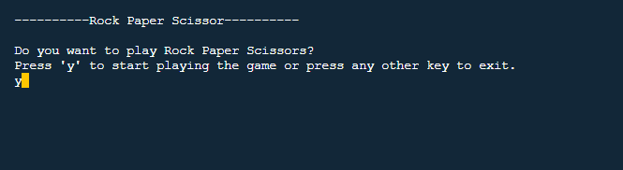
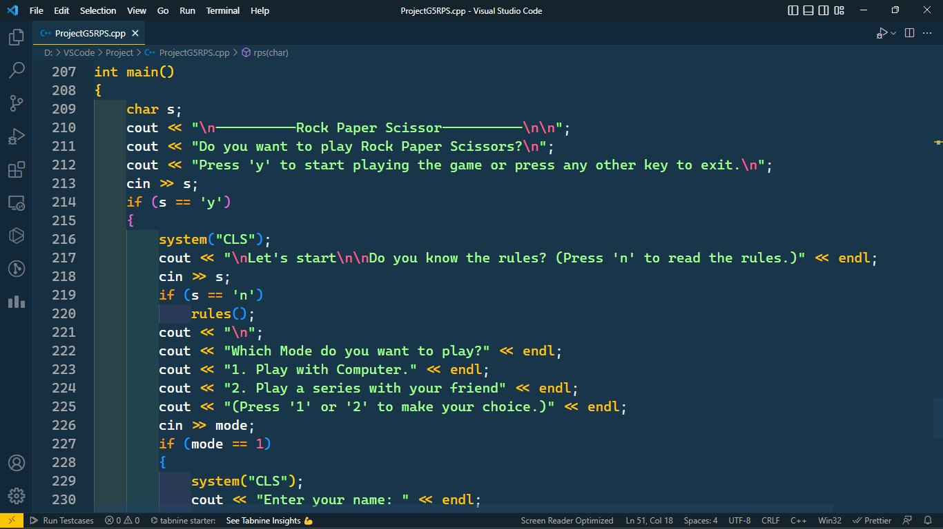

Methodology
Code:
Output:
Explanation:
These lines of code will show us the name of the game, which is Rock, Paper, Scissor. Then it will ask us if the user wants to play the game. User will have to press ‘y’ to start the game. If the user wishes not to play the game, then the user can press any other key and quit the game.
If the user presses ‘y’, then the game will start.

Slide 6
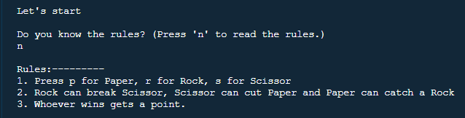
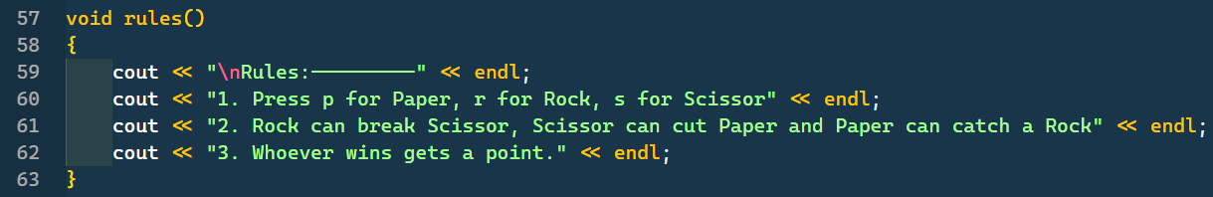
Want to know rules?
Code:
Output:
Explanation:
If user pressed ‘y’ to start the game then this piece of code will greet the user and will ask if the user wants to know the rules.
If the user have played the game before then he/she can skip the rules. Anyway if the user wants to know the rules then user will have to input ‘n’.
If user press ‘n’ then the rules() function will be called and rules will be shown as the given output.

Slide 7

Which mode?
Code:
Output:
Explanation:
In this section of code, the user will be asked which mode he/she wants to play.
In mode 1, the user can play with CPU. After every round he will be asked if he wants to play again.
In mode 2, two users can play the game together in a series. Whoever will have more point in the end will win the series and will be declared as the winner.

Slide 8
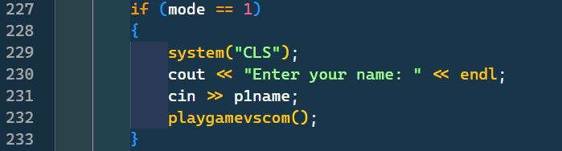
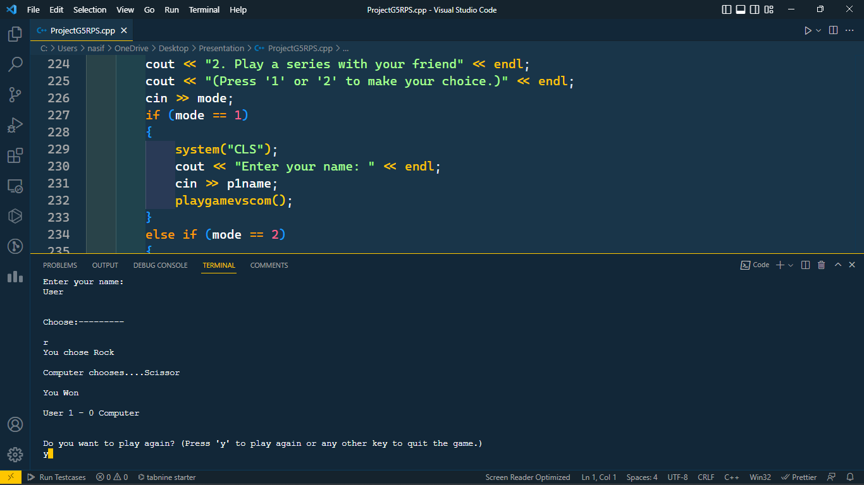
Player vs Computer
Code:
Output:
Explanation:
If the user pressed 1 to play with computer then the user will be asked his name and then the game will start.
Playgamevscom() function will be called.
This function requires the code to play the with CPU.

Slide 9
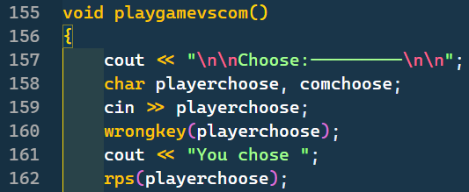
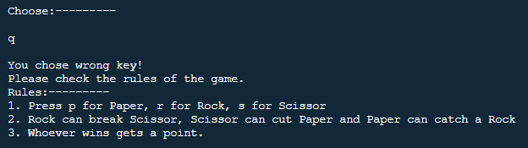
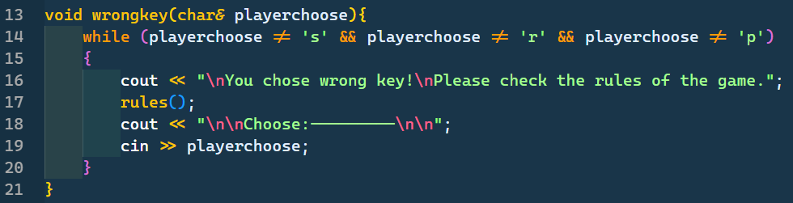
playgamevscom() explained [Part 1]
Code:
Output:
Explanation:
The user will have to choose then. If the user chooses anything else except r, p and s then wrong key function will be called.
wrongkey() function will tell the user about wrong input. It will show the rules and take input from the user until the user gives the right input. The user will have to give the right input to pass the function.

Slide 10
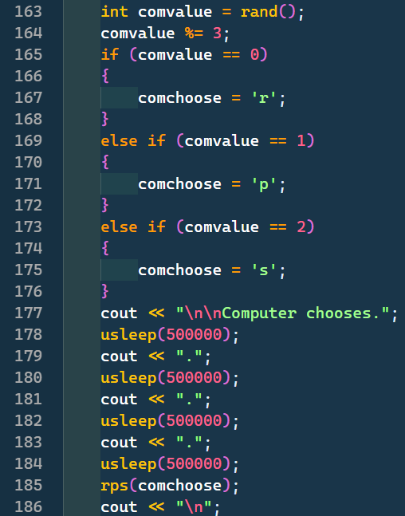
playgamevscom() explained [Part 2]
Code:
Output:
Explanation:
In this section,
Computer will randomly choose a number. Then we will module that number by 3. By this we can get 0,1 or 2.
We assigned 0 as rock, 1 as paper and 2 as scissor.
So, every time it will be random what CPU chooses.
We added a small animation which would create excitement for the user about what the CPU would choose, then it would be shown.

Slide 11
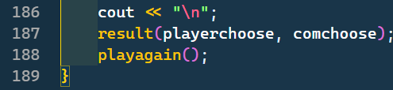
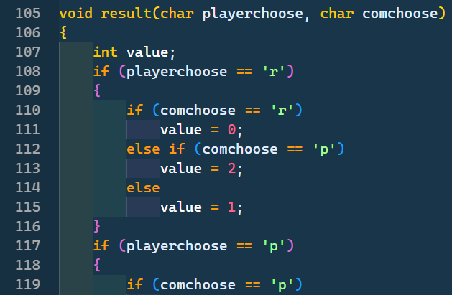
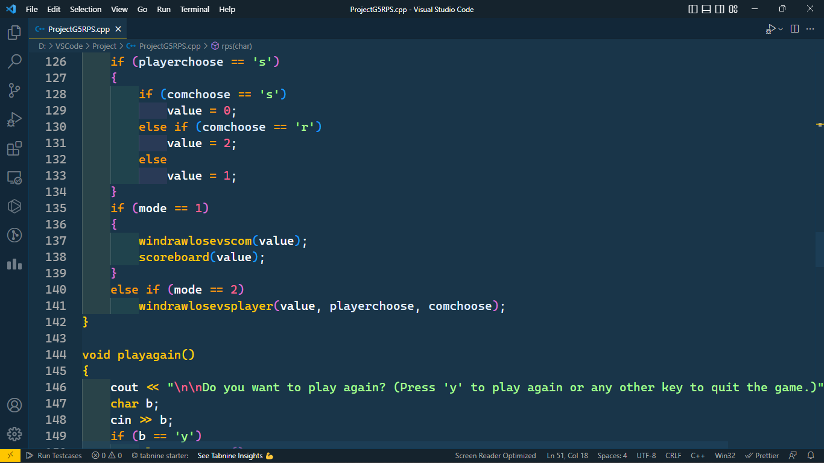
result() explained
Code:
Explanation:
This function will call another function called result. It will the show the game result.
Result function will compare what the user chose and what computer chose. Here value will store 0,1 and 2 as result.
Value 0 means it’s a draw.
Value 1 means the user has won the game.
Value 2 means CPU has won the game.
windrawlosevscom() will be called to declare to show who won and scoreboard() function to show the score.

Slide 12
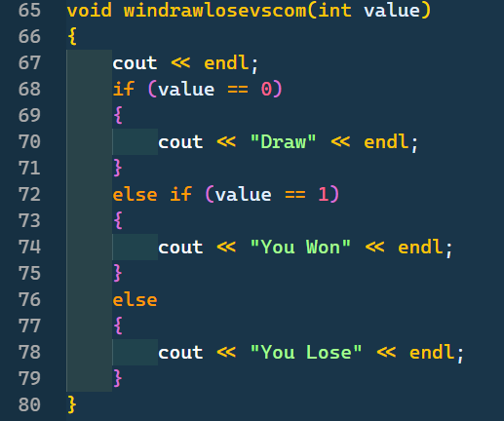
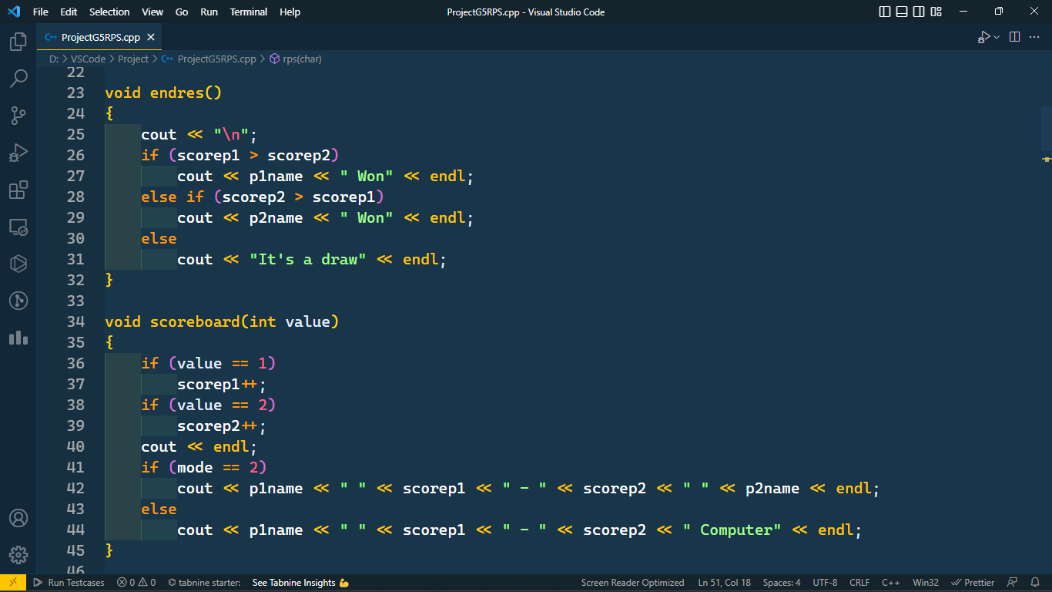
windrawlosevscom() and scoreboard() explained
Code:
Output:
Explanation:
Here, user chose Rock and CPU randomly chose Scissor.
As a result user won and the windrawlosevscom() showed that the user won.
Then scoreboard() function is called and the score is updated and showed.

Slide 13
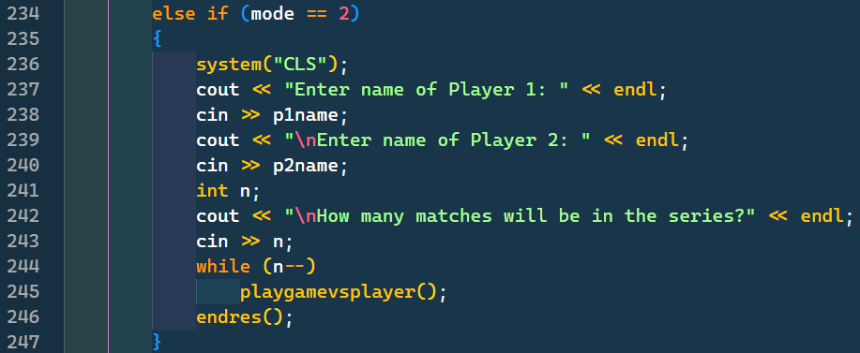
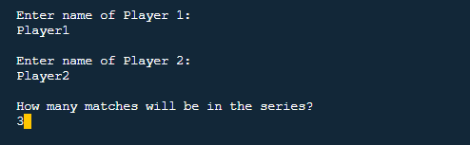
Player vs Player
Code:
Output:
Explanation:
In this mode,
Two users will be asked their name first and then they will be asked how many matches they want to play. Then the game will start.
playgamevsplayer() will be called as many times users wanted to play.

Slide 14
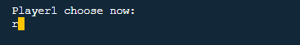
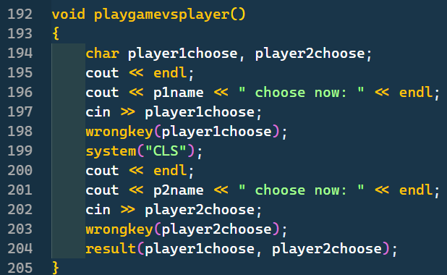
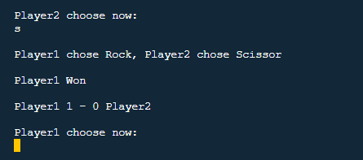
playgamevsplayer() explained
Code:
Output:
Explanation:
User 1 will be asked to choose first. After that the screen will be cleared. This is because User 2 shouldn’t know what user 1 chose.
Then User 2 will be asked to choose. Both player need to give correct input to pass wrongkey() function. Then as before result function will be called. After the process, windrawlosevsplayer() will be called.

Slide 15
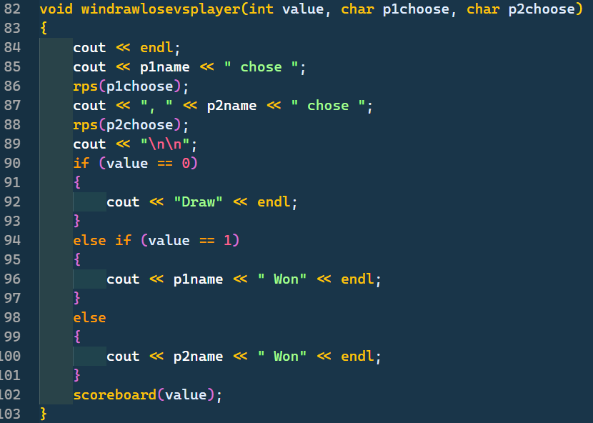
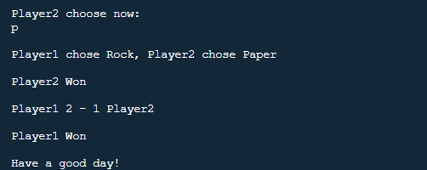
windrawlosevsplayer() and endres() explained
Code:
Output:
Explanation:
The windrawlosevsplayer() function will show everytime who chose which one and who won.
After the end of the series, the final score will be shown and it will be declared who won or if it is a draw.
Finally users will be greeted again and the program will end.

Slide 16


